Slide 1

KS3 Mathematics
N2 Multiplying and Dividing Integers
Notes:
The aim of this unit is to teach pupils to:
Order, add, subtract, multiply and divide positive and negative numbers.
Material in this unit is linked to the Key Stage 3 Framework supplement of examples pp 48-51.

Slide 2


Multiplying and dividing integers
–3 + –3 + –3 + –3 + –3 =
–15
–3
–3
–3
–3
–3
–15
–12
–9
–6
–3
0
5 × –3
= –15
A positive number × a negative number = a negative number
Notes:
Ask the class to work out –3 + –3 + –3 + –3 + –3.
The answer is –15, as we can see on this number line.
How do we usually add together the same number many times? (We multiply)
Another way to write –3 + –3 + –3 + –3 + –3 is 5 × –3.
So, 5 × –3 = -15.
In fact, when we multiply a negative number by a positive number, the result is always a negative number.
Reveal the rule on the board.

Slide 3
Multiplying and dividing negative numbers
–7 × 3 =
= 3 × –7 =
–21
–7
–7
–7
–21
–14
–7
0
A negative number × a positive number = a negative number
Notes:
Now, what is –7 × 3?
We know that when we multiply it does not matter what order we put the numbers in so –7 × 3 is exactly the same as 3 × –7. This is called the commutative law.
It is not necessary for pupils to know the name of the law at this stage as long as they are familiar with the idea.
Again, we can see this illustrated on a number line.
The next rule we need to remember is that when we multiply a positive number by a negative number, the result is always a negative number.

Slide 4
Multiplying and dividing negative numbers
–4 × –6 =
24
– –6
– –6
– –6
– –6
0
6
12
18
24
A negative number × a negative number = a positive number
Notes:
Explain that multiplying a negative number by another negative number is like subtracting a negative number. Subtracting a negative number is equivalent to adding the positive value of that number. Multiplying –6 by –4 is equivalent to subtracting –6 four times which is equivalent to adding 6 four times.
Multiplying by a negative number has the effect of changing the sign of whatever it is multiplying.
We have seen that multiplying a positive number by a negative number, in whatever order, makes the answer negative. Well, multiplying a negative number by another negative number makes the answer positive.
–4 × –6 = 24

Slide 5


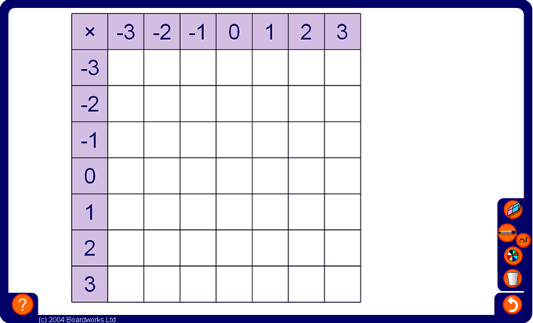
Ordered multiplication square
Notes:
Start by working out the positive number multiplications 3 × 0, 3 × 1, 3 × 2 and 3 × 3.
Ask pupils the answer to 3 × –1, using the number pattern in the table, or using the rules from the previous slide, and fill in the rest of the row to 3 × –3.
Repeat in the same order for the next 2 rows.
Establish that 0 × any number is 0 and fill in this row accordingly.
For the last three rows fill in the first answer by looking at the pattern in the first column and continue along the row.
Before revealing each answer ensure that the question corresponding to that cell has been clearly stated. For example,
What is 1 × –2?
Pupils may then look for number patterns to deduce the answer or use the rules on the previous slide.
Once the table is complete, ask pupils to point out any patterns they notice. Shade the negative numbers blue and shade the positive numbers green.
Ask pupils to use the table to answer some given questions.
For example,
Use the table to work out –2 × –1.

Slide 6
Rules for multiplying and dividing
When multiplying negative numbers remember:
+
×
+
=
+
+
×
–
=
–
–
×
+
=
–
–
×
–
=
+
Dividing is the inverse operation to multiplying.
When we are dividing negative numbers similar rules apply:
+
÷
+
=
+
+
÷
–
=
–
–
÷
+
=
–
–
÷
–
=
+
Notes:
These rules have been drawn graphically to make it easier for pupils to spot the pattern.
As each rule appear read it as, for example,
A positive number multiplied by a positive number always equals a positive number.
Remind pupils of the meaning of ‘inverse operation’ – one ‘undoes’ the other.
For example, if 4 × –3 = –12, then –12 ÷ –3 must equal 4.
Tell pupils that easiest way to remember these rules is that when we multiply together (or divide) two numbers with different signs (a positive number times a negative number or a negative number times a positive number) the answer will always be negative. If we multiply together (or divide) two numbers with a different sign (a positive number times a positive number or a negative number times a negative number) the answer will always be positive.
Encourage pupils to first work out whether their answers will be positive or negative and then multiply or divide.
Ask pupils to write down rules for multiplying (or dividing) three numbers.
For example, negative × positive × negative = positive and negative × negative × negative = negative.

Slide 7
Multiplying and dividing integers
Complete the following:
–3 × 8 =
–24
9
–36 ÷ = –4
42 ÷ = –6
–7
540
÷ –90 = –6
–12
× –8 = 96
–25
–7 × = 175
47 × = 141
–4 × –5 × –8 =
–160
3
–72 ÷ –6 =
12
–16
3 × –8 ÷ = 1.5
Notes:
For each example ask pupils what sign the missing number will have and then what the number is.
Links:
Mental methods – multiplication and division
Equations – solving equations

Slide 8

Using a calculator
We can enter negative numbers into a calculator by using the
sign change key:
(–)
For example:
–417 ÷ –0.6 can be entered as:
(–)
4
1
7
÷
(–)
0
.
6
=
The answer will be displayed as 695.
Always make sure that answers given by a calculator are sensible.
Notes:
Ask pupils to locate the sign change key on their calculator. Note that on some non-scientific calculators this key may be shown as +/– and must be pressed after the number is entered to make it negative.
Discuss ways that we can check that the answer given by the calculator is correct.
First check that the sign is correct. In this example, we are dividing a negative number by another negative number and so the answer must be positive.
417 ÷ 0.6 is approximately equal to 420 ÷ 0.6 = 420 ÷ 6 × 10 = 700.
Set pupils a variety of problems involving negative numbers including negative decimals. As an extension include problems involving negative fractions.
Links:
Written and calculator methods – Using a calculator

Slide 9

Mixed multiplication square
Notes:
Work out the numbers in the empty squares by multiplying and dividing.

Slide 10
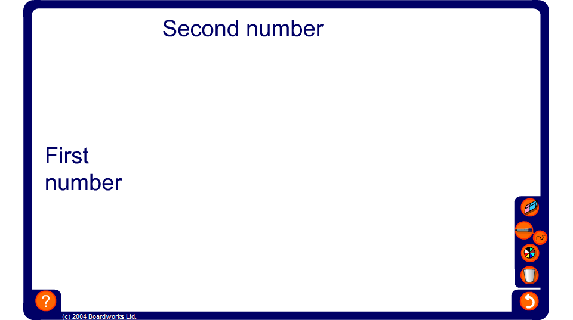
Mixed division square
Notes:
Work out the numbers in the empty squares by multiplying and dividing.

Slide 11
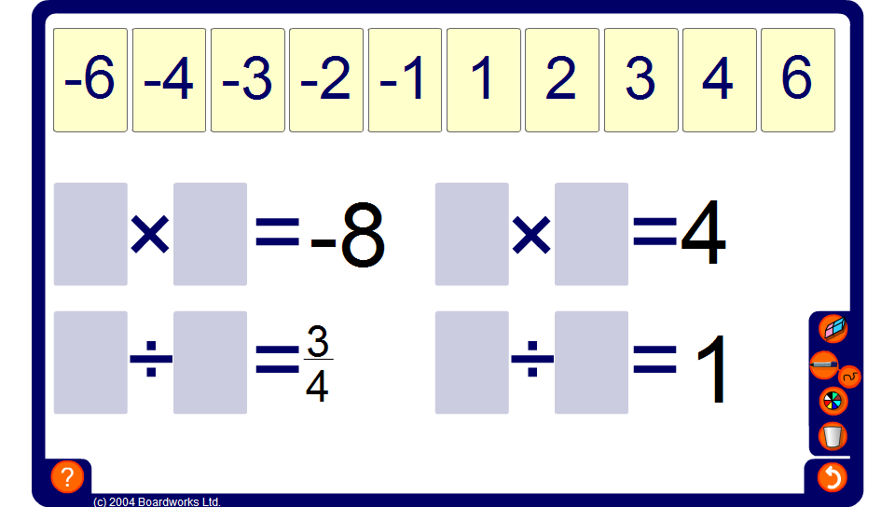
Integer cards – multiplication and division
Notes:
Challenge pupils to find every possible solution for each calculation using the given set of integer cards.
Establish that if the answer to the calculation is negative the signs of the numbers we are multiplying or dividing must be different (one positive and one negative). If the answers to the calculations is positive the signs of the numbers we are multiplying or dividing must be the same (both positive or both negative).

Slide 12


Number spiral
–2
–8
–10
×2
÷ –5
–4
2
–11
–7
+ 4
– 5
× –1
3
–15
0
–16
–2
+ 16
× 5
+ 8
–3
6
÷ –2
Notes:
Work towards the centre of the spiral to reveal the picture of a snail blinking.

